Slide 1


Slide 2
Index
What is the goal of this movie?
Presentation of the movie
Autor
Time
Some numbers
Release date
Warzone quote
Different types of weapons
Main characters
The life of a bullet

Slide 3
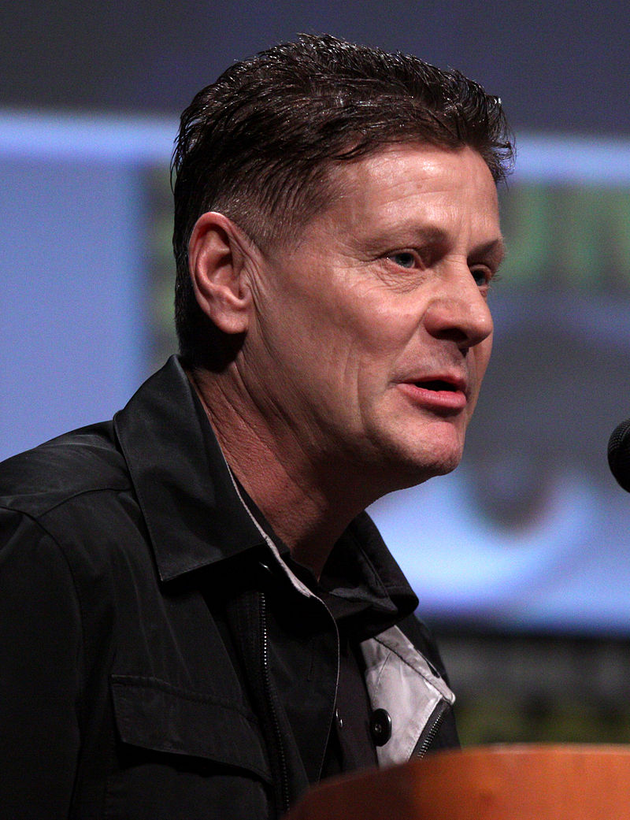
Presentation of « War Lord »
Release date - Septembre 16th 2005 in USA
- January 4th 2006 in France
- February 16th 2006 in Germany
Running time – 123 min
Budget - $50 million
Box office $72,6 million
Warzones quoted: USA , south Africa, Russia name URSS, liban, liberia
Director – Andrew Niccol

Slide 4
Presentation of « War Lord »
Differents types of weapons
Submachine gun
Pistol of differents power
Rocket launcher
Civil weapons (can use everywhere)
Fetish weapon : ak 47 and the uzi

Slide 5
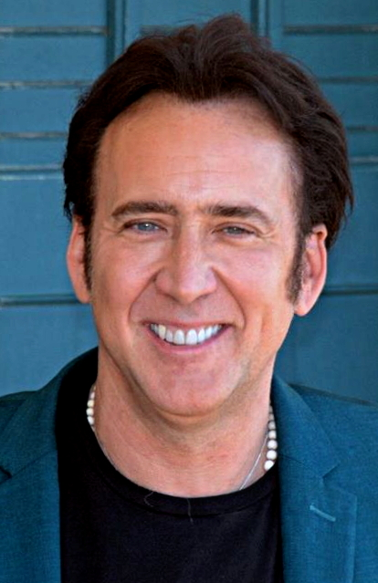
Presentation of « War Lord »
- Main character Yuri Orlov
- Ukranian family
- Move to USA, cold war
Gunrunner
Father
Stop for a moment
Restart again after problems

Slide 6
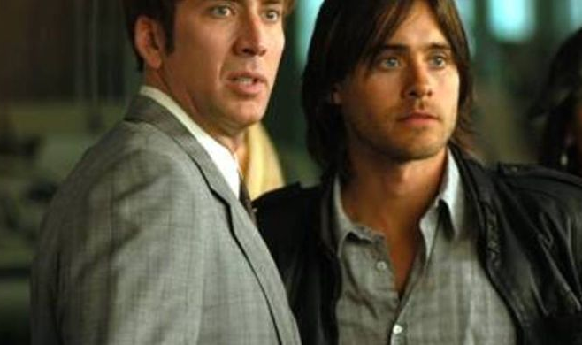
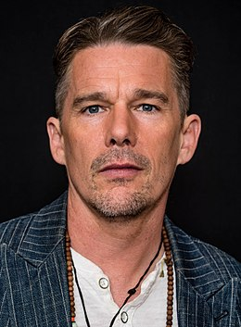
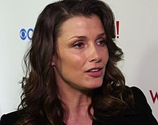
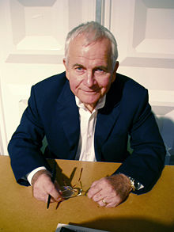
Mains characters
Yuri Orlov
Vitaly Orlov
Irina and Anatoli Orlov
Eva Fontaine
Jack Valentine (interpol)
Simeon Weisz (competitor)

Slide 7
The life of a bullet 7.62 by 33 mm
https://www.youtube.com/watch?v=I4TOYp0_6lc
1min02 – 3min45
1 – Factory (1min02 – 2min17)
2 – Transport (2min17 – 2min30)
3 – End(2 min 30 – 3min 20)
4 – Battlefield (2min30 -3min 42)
5 – in the head (3min42 - 45)

